Slide 1
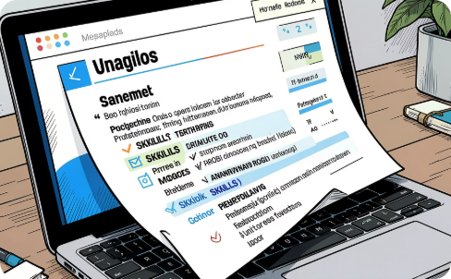
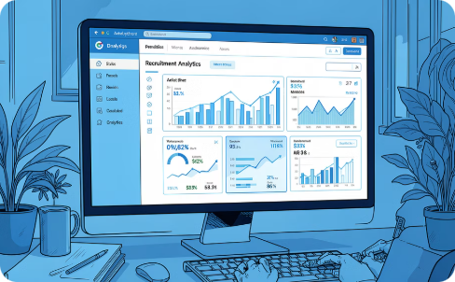
Resume Screening & Application Tracking System
Mini Project — 2026
Team Members: • SHAIKH SANAA IRAM M (23AK1A05I6) • SHASHANK P N (23AK1A05I7) • SNEHA LATHA K (23AK1A05J3)
Brief overview: "A web-based system designed to automate candidate screening, application tracking, and recruitment management."
Purpose
Outcome
Automate resume screening to save time, reduce bias, and centralise applicant data for convenient recruiter access.
Provide analytics-driven insights and downloadable reports to support data-informed hiring decisions.

Slide 2
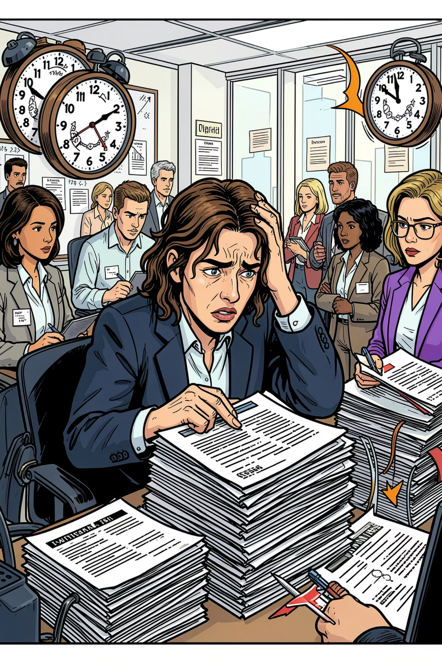
Problem Statement
Time-Intensive Manual Screening
High Volume Management Challenges
Human Error & Bias
Manual evaluation risks oversight, inconsistent scoring, and unconscious bias affecting shortlisting.
Reviewing resumes one-by-one consumes significant recruiter hours and delays hiring cycles.
Thousands of applications lead to inconsistent tracking, lost candidates, and fragmented communication.
Need for Efficient Tracking
Organisations require a reliable system to monitor application stages, statuses and recruitment KPIs.
Visual summary: The combination of time pressure, volume, and human variability creates a compelling case for automation and centralised tracking.

Slide 3

Methodology & System Approach
System flow (detailed): • Candidate submission: Structured form + resume upload extracts name, contact, education, experience and skills. • Recruiter input: Define role-specific required and preferred skills, experience thresholds and weightings. • Parsing & matching: Text parsing (keyword extraction), normalisation of skill synonyms, and weighted comparison produce a match percentage for each candidate. • Automated categorisation: Thresholds determine status — Applied, Shortlisted, or Rejected — with manual override by recruiters. • Dashboard & analytics: Real-time metrics (applications by role, shortlist rate, time-to-hire), candidate pipeline visualisation and exportable reports (CSV/PDF).
Data Storage
Automation Engine
Reporting
Structured candidate records with audit trail for status changes and recruiter notes.
Rule-based filters and matching algorithm compute match percentage and ranking.
Customisable dashboards, charts and downloadable analytics for evaluation panels.

Slide 4
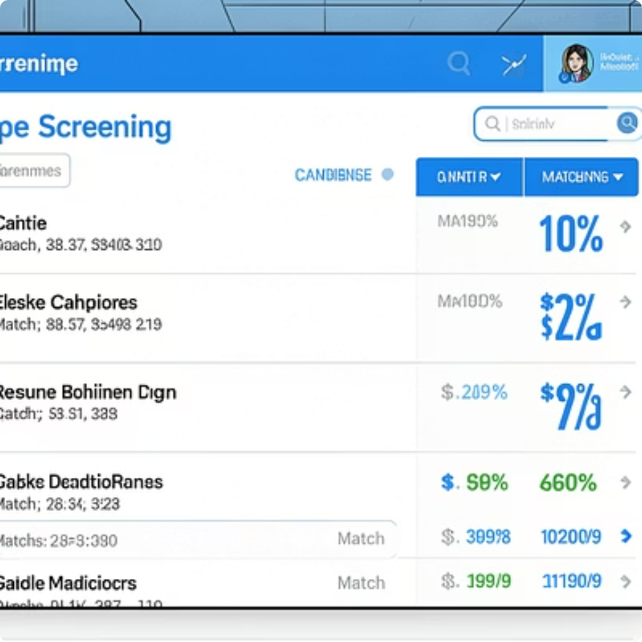
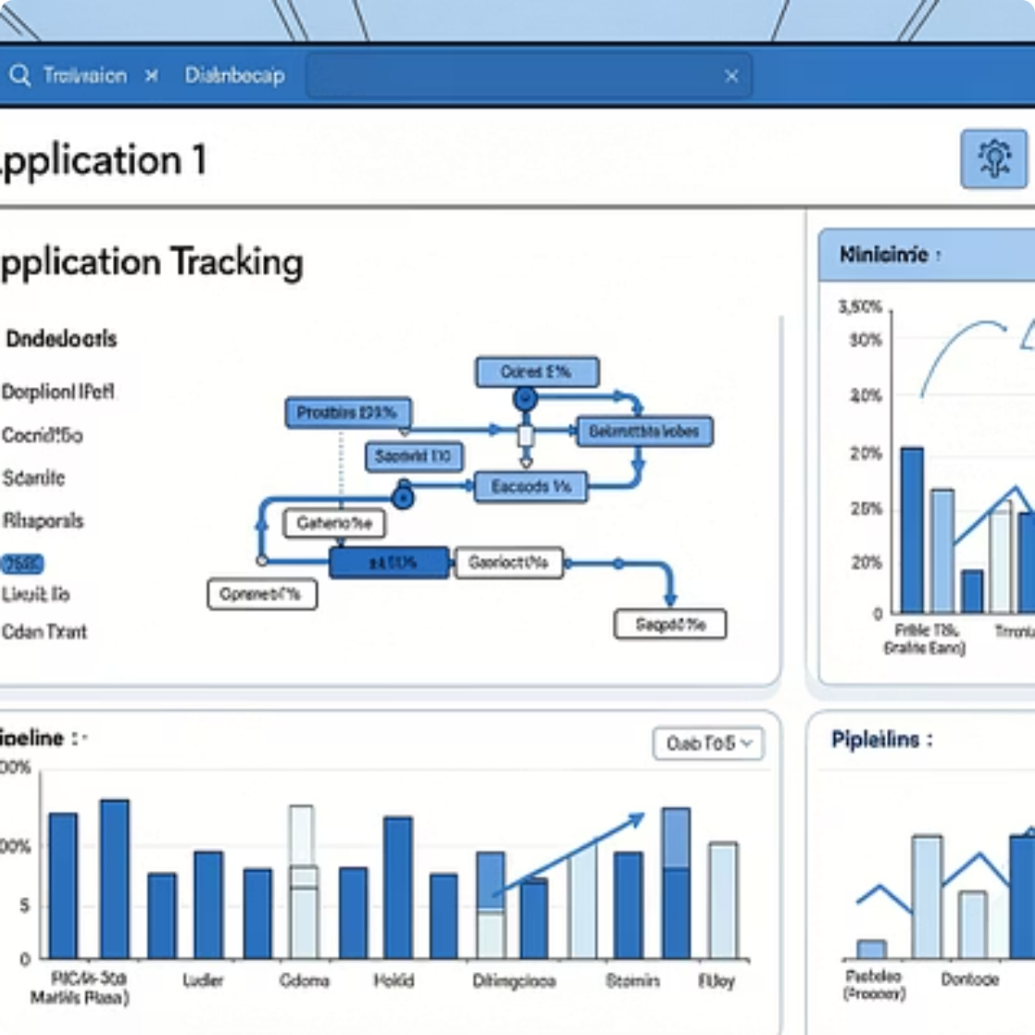
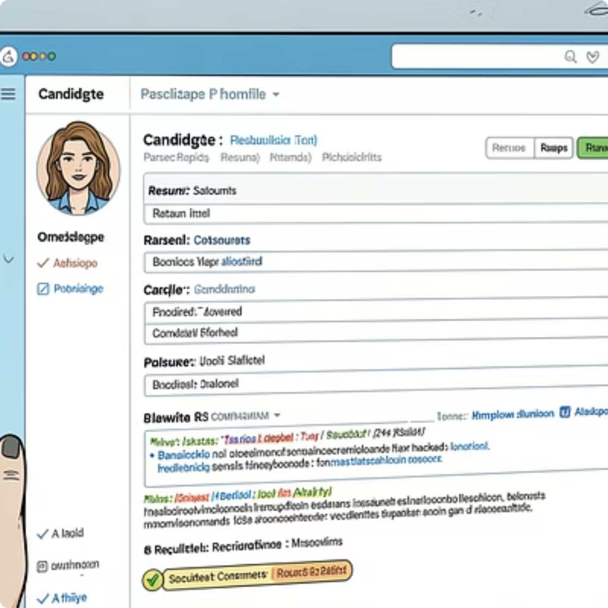

Results & Demonstration
Key outcomes observed during testing and demonstration: • Faster screening: Initial triage reduced average review time per candidate by an order of magnitude (automated parsing and scoring). • Improved management: Centralised application pipeline prevented candidate loss and simplified communication logs. • Consistent evaluation: Automated match percentages standardised shortlist decisions, with manual review for edge cases. • Recruiter-ready exports: Downloadable reports summarise candidate pools, top matches, and historical recruiting metrics.
Demonstration notes: Screenshots show prototype UI, responsive dashboard and clear match-scoring used for shortlist recommendations.

Slide 5
Conclusion & Future Scope
Simplifies Recruitment
Centralises candidate data, automates initial screening and streamlines the hiring pipeline for academic and small enterprise use.
Reduces Manual Effort
Automated parsing and scoring reduce repetitive tasks, allowing recruiters to focus on high-value interview stages.
Data-Driven Hiring
Dashboards and exportable reports enable evidence-based decisions and support evaluation by faculty and industry partners.
User-Friendly Web Solution
Accessible interface designed for ease-of-use by recruiters and academic project evaluators.
Future Scope
Resume Upload improvements: richer parsing (PDF/DOCX), OCR for scanned documents and normalisation of skill taxonomies.
Cloud Database Integration: scale to larger candidate volumes with secure, redundant storage and role-based access control.
Advanced AI-based Screening: semantic matching, intent recognition and debiasing algorithms to improve accuracy and fairness.
Email Notifications & Workflow Automation: automated candidate communications, interview scheduling and feedback collection.
Final note: The system delivers a professional, blue-and-white corporate UX suitable for academic evaluation. Images and UI mockups include balanced representation of men and women across hiring contexts.

